Slide 1



COMPSCI 326
Lesson 04: JavaScript Objects

Slide 2
Resources
MDN Web Docs
JavaScript
JavaScript data types and data structures
Object
Functions
this keyword
Video tutorial about objects: https://www.youtube.com/watch?v=37YIF_evtEk

Slide 3
Last Time

Slide 4
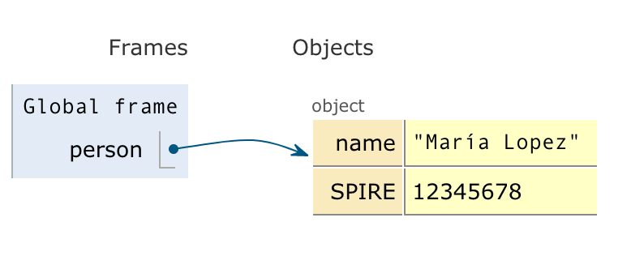
Objects - property access
We can access objects in two ways:
Like an array with brackets: person[‘name’]; ⇒ ‘María Lopez’ let id = ‘name’; person[id]; ⇒ ‘María Lopez’
Or like objects (similar to Java): person.name; ⇒ ‘María Lopez’
let person = { 'name' : 'María Lopez', 'SPIRE' : 12345678 };
Image from JavaScript Tutor - Visualize JavaScript code execution to learn JavaScript online - great place to try out snippets of JavaScript code!

Slide 5
Objects - property access
When to use brackets vs dots?
brackets
Use [] when you use a variable to access a property (like person[x])
When the property name contains characters that are not a valid identifier (person[‘favorite color’])
dots
When you know what the property is (e.g., person.name)
This is less verbose, more “JavaScripty”
Easier to catch your misspellings
let person = { 'name' : 'María Lopez', 'SPIRE' : 12345678 };
Image from JavaScript Tutor - Visualize JavaScript code execution to learn JavaScript online - great place to try out snippets of JavaScript code!

Slide 6
Objects - property existence
You can check if a property is in an object:
Using the in operator: ‘name’ in person; ⇒ true ‘age’ in person; ⇒ false
BEWARE: it is not an error if you try to access a property that doesn’t exist: person.age; ⇒ undefined person[‘age’] ⇒ undefined
let person = { 'name' : 'María Lopez', 'SPIRE' : 12345678 };
Image from JavaScript Tutor - Visualize JavaScript code execution to learn JavaScript online - great place to try out snippets of JavaScript code!

Slide 7
Objects - property deletion
You can delete a property from an object:
Using the delete operator: delete person.name; ⇒ true delete person[‘name’]; ⇒ true person; ⇒ {‘SPIRE’: 12345678}
BEWARE: it is not an error to delete a property that doesn’t exist: delete person.age; ⇒ true delete person[‘age’] ⇒ true
let person = { 'name' : 'María Lopez', 'SPIRE' : 12345678 };
Image from JavaScript Tutor - Visualize JavaScript code execution to learn JavaScript online - great place to try out snippets of JavaScript code!

Slide 8
Objects - to strings and back again
You can convert objects into strings and back
Using the JSON.stringify function: let str = JSON.stringify(person); str; ⇒ '{"name":"María Lopez","SPIRE":12345678}'
Using JSON.parse function: JSON.parse(str) ⇒ {name: 'María Lopez', SPIRE: 12345678}
let person = { 'name' : 'María Lopez', 'SPIRE' : 12345678 };
Image from JavaScript Tutor - Visualize JavaScript code execution to learn JavaScript online - great place to try out snippets of JavaScript code!

Slide 9
Today
Objects In-Depth
Properties
Nested Objects
Object Functions / this keyword
Creating objects with new
Characters, ASCII, Unicode (UTF-8)
Browser Debugging

Slide 10
Properties
Objects can have properties
What is really going on?

Slide 11
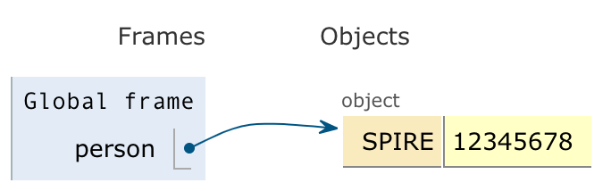

Properties
Objects can have properties
What is really going on?
Properties can be anything, you can add them by assigning to them.
let person = {};

Slide 12
Properties
Objects can have properties
What is really going on?
Properties can be anything, you can add them by assigning to them.
let person = {}; person.SPIREID = 12345678;

Slide 13
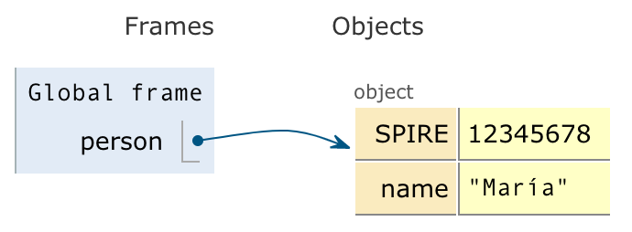
Properties
Objects can have properties
What is really going on?
Properties can be anything, you can add them by assigning to them.
let person = {}; person.SPIREID = 12345678; person.name = ‘María’;

Slide 14
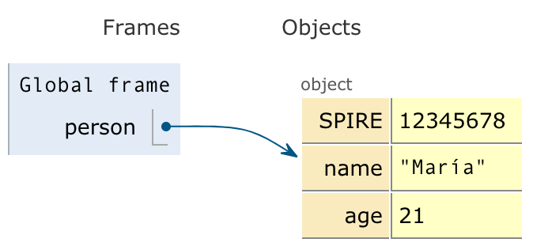
Properties
Objects can have properties
What is really going on?
Properties can be anything, you can add them by assigning to them.
let person = {}; person.SPIREID = 12345678; person.name = ‘María’; person.age = 21;

Slide 15

Properties
Objects can have properties
What is really going on?
Properties can be anything, you can add them by assigning to them.
let person = {}; person.SPIREID = 12345678; person.name = ‘María’; person.age = 21; person.hometown = { city: ‘Petersham’, state: ‘Massachusetts’, country: ‘USA’, };

Slide 16
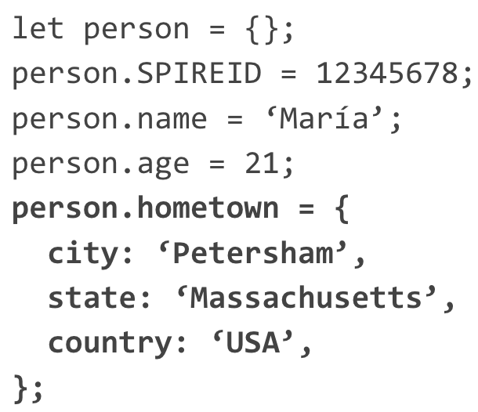
Object Functions / this keyword
person.print = () => {
console.log(this.name + ‘ds’ + this.SPIRE);
};

Slide 17
Making new objects
let o = {};
OR
let o = new Object();

Slide 18
Characters: ASCII / Unicode (UTF-8)
(important for Scrabble and today's exercise)
Characters of text internally represented as numbers
Originally, a very limited set, "Latin" alphabet - "ASCII", only 127 characters!
Today, we use UTF-8
UTF-8 is backwards compatible with ASCII
UTF-8 can represent all of the world's character sets
For the "Latin" alphabet, we can use this:
str.charCodeAt(0) to get the number
String.fromCharCode(num) to get the character

Slide 19
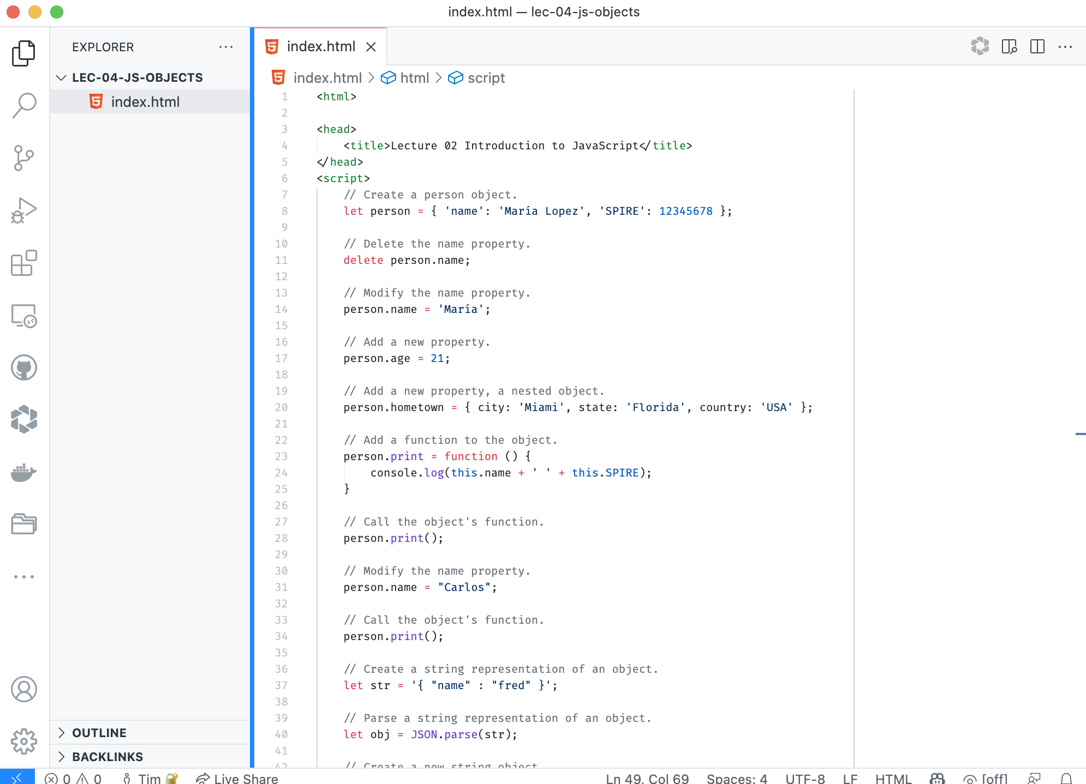
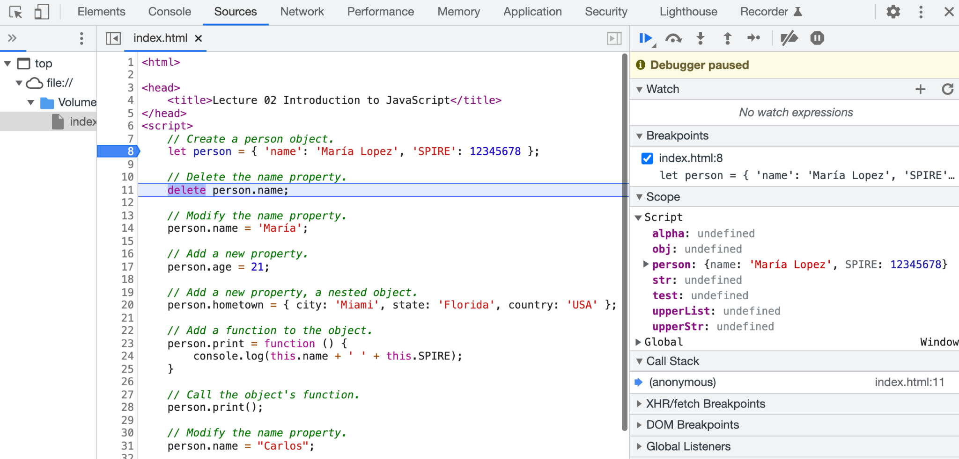
Browser Debugging
Chrome Dev Tools Debugger
VSCode

Slide 20

The End

